Slide 1
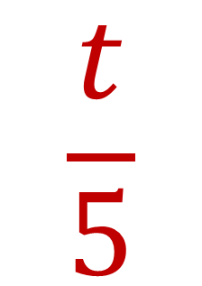
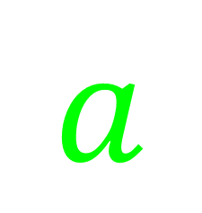





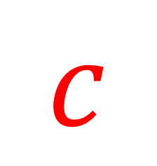

My Using
Letter Symbols Interactive
Notebook
$$×$$
$$\frac{1}{e}$$
$$a$$
$$3b$$
$$−$$
$$\frac{t}{5}$$
$$c$$
Name
Class
Teacher
Term 1 Semester 1
$$p^{2}$$
$$\sqrt{x}$$
1

Slide 2
Create your own front page
It needs to contain the following –
My number interactive notebook
Name
Class
Teachers Name
Semester 1 Term 1
Page number 1

Slide 3
Contents
Glossary or Formula Page
Page
Date
Description
2
3

Slide 4
Tasks
24
7
30
Essential Question
Questions
Notes
Summary
4
5

Slide 5
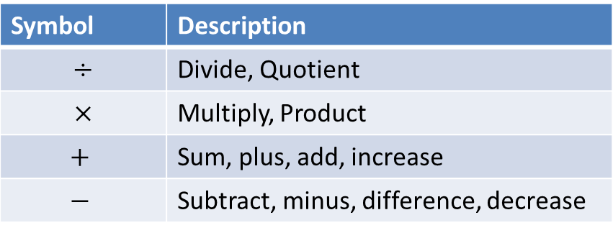
24
7
30
Date
Using letter symbols
EQ – How can I write expressions using symbols to represent numbers?
What symbols do we use?
Symbol | Description
$$÷$$ | Divide, Quotient
$$×$$ | Multiply, Product
$$+$$ | Sum, plus, add, increase
$$−$$ | Subtract, minus, difference, decrease
What is a variable?
The letter used to represent an unknown number
5

Slide 6
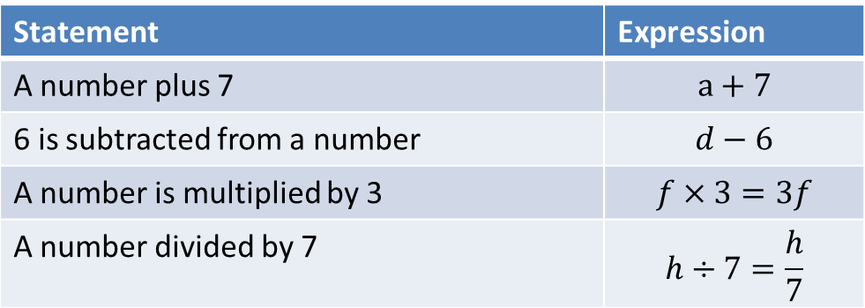
24
7
30
Date
Using letter symbols
EQ – How can I write expressions using symbols to represent numbers?
What symbols do we use?
Symbol | Description
$$÷$$ | Divide, Quotient
$$×$$ | Multiply, Product
$$+$$ | Sum, plus, add, increase
$$−$$ | Subtract, minus, difference, decrease
What is a variable?
The letter used to represent an unknown number
Statement | Expression
A number plus 7 | $$a+7$$
6 is subtracted from a number | $$d−6$$
A number is multiplied by 3 | $$f×3=3f$$
A number divided by 7 | $$h÷7=\frac{h}{7}$$
5

Slide 7
Notes Review
24, 7 ,30
Date
Title
Essential question
Notes complete
Notes complete with colour and diagrams
Questions completed
Contents page filed in
Formula page filled in

Slide 8
Homework
Review your notes and write a summary answering the essential question.

